Slide 1
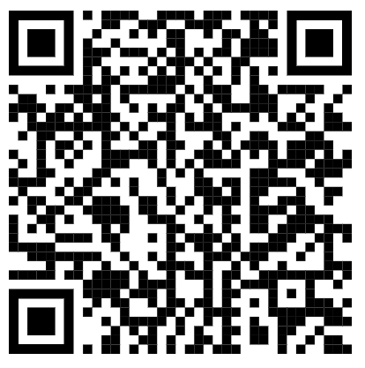
Business Case
Using Data to Understand Customer Behavior and Support Retention Decisions
An organization offering a widely used consumer financial product has started to observe a consistent decline in active customers. While overall acquisition remains stable, a growing number of customers reduce their usage or stop engaging with the product altogether.
From a business perspective, this is not only a customer loss problem. It directly impacts future revenue, reduces opportunities for cross-selling, and affects the efficiency of commercial and operational efforts. However, the organization does not have a clear understanding of why customers are leaving, nor how early those signals can be detected.
The company has access to historical data on its customers, including both those who remain active and those who have left. This data includes information about customer profiles, their relationship with the organization, and their recent behavior in terms of product usage and interactions.
The goal is not simply to describe the data, but to use it to better understand the dynamics behind customer attrition.
More specifically, the organization is trying to answer questions such as:
What differentiates customers who remain active from those who leave?
Are there early signals that indicate a weakening relationship before a customer churns?
Are these signals more related to who the customer is, or to how they behave over time?
Can we identify patterns that consistently precede customer exit?
This involves:
Exploring the data to identify meaningful patterns
Interpreting those patterns in a business context
Assessing whether they can help anticipate customer attrition
Reflecting on how this information could be used to support decision-making

Slide 2
Business Case
How to explore the data
1. Who are the customers? Do profile and relationship variables explain differences in churn?
2. How is the customer behaving? Are there differences in activity, usage, or interaction?
3. Is something changing over time? Do customers who leave show signs of decline before churn?
Type of Information | Variables
Customer Profile | Customer_Age, Gender, Dependent_count, Education_Level, Marital_Status, Income_Category
Relationship with Company | Months_on_book, Total_Relationship_Count, Card_Category, Credit_Limit
Activity & Interaction | Total_Trans_Amt, Total_Trans_Ct, Avg_Utilization_Ratio, Contacts_Count_12_mon
Behavioral Change | Total_Amt_Chng_Q4_Q1, Total_Ct_Chng_Q4_Q1
Outcome | Attrition_Flag

Slide 3
Business Case
How to explore the data
What differentiates churn vs non-churn customers
“Which signals felt clearer to you?” “Which ones were more ambiguous?” “Which blocks seem more informative?”

